Slide 1
Development - Planning
The first thing we did was sit down and plan out exactly what we wanted in our game. We came up with the following
Sword
Bow and Arrow
Boss and Mini Boss
High HP enemy, High damage enemy, flying enemy
Essentially, what we wanted was pretty close to a LttP clone.

Slide 2
Development - Framework
From here, the next step was obvious – we needed to write the backend classes. To this end we created the model, view, and controller classes. From there, we decided the most appropriate way to continue would be to write an overarching GameObject abstract class that provided fields and methods that would be necessary for everything. Location on screen, height, width, etc. This was then extended into smaller abstract classes like Character, Obstacle, and Item and provided more appropriate fields and methods, all of which were further extended by their more specific classes like Player, Grass, and SpeedBuff.

Slide 3
Development – Backend
Once we had our framework designed, we needed to figure out how we were going to generate the map and move around it. To achieve that, GameMap and Area classes were created. GameMap’s constructors built a number of Area classes and stored them in an array, and Area’s were built by feeding their constructor an ArrayList of Enemy objects and an ArrayList of Obstacle objects. This allowed us to associate each Area with a specific part of the game’s map and to associate each Area with a specific design in regards to enemies and obstacles.

Slide 4
Development – Backend cont.
Once that was done, we had to figure out exactly how the game engine should work and decided on an AnimationTimer as suggested in the platformer game’s spec. We had this keep track of an internal gameclock and every fourth tick of the game clock we had it update the position of the player based on keyboard listeners, update enemy positions based on player position, update any projectiles on screen, and check for win/lose conditions.

Slide 5
Development – Backend cont. 2
Finally, we used axis aligned bounding boxes as hitboxes and did a simple O(n²) collision check, each moving object checked once against each object (including weapon swings and projectiles). With the size of our screen the number of objects on screen is never large enough for this to present a problem, though with larger more in depth games an AABB tree would be used.
To draw images to screen, we simply made sure that our view observed our model and that our model notified observers once per tick. The view’s update method then drew everything to screen once per tick. Again, with the size of our screen this doesn’t present a problem, though with more in-depth maps it would have been better to place moving objects in a different layer and just move those.

Slide 6
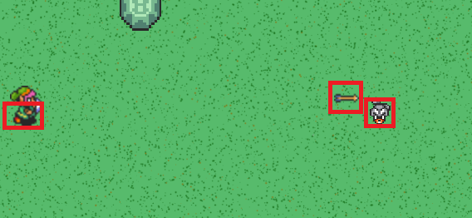
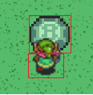
Axis-aligned Bounding Boxes
Basically, rectangles with edges normal to the x and y axis. Note, the player’s hitbox is smaller. This allows us to force perspective, as seen on the right image.

Slide 7
Development - Animation
No huge issues here. Since the update is called once per tick it was natural to use graphics context to draw a different frame to the canvas based on the game clock. Some nifty things we did were drawing the tops of the tall objects after the rest to give the illusion of perspective, as well as using a list of animations to let us walk our character under the animation of a bush being destroyed but over top of the bush’s stump that remains on the ground.

Slide 8
Development - Sound
Here we had two types of sounds – Background music and sound effects. For background music, since everything was abstracted pretty well, all we had to do was throw a Boolean check in to see when we swapped from the overland to the dungeon and vice-versa to change what music was playing. For sound effects, we were able to just store an ArrayList<AudioClip> in the controller and add a sound effect to the list whenever an action occurred that warranted it. Then when views update() runs, it just grabs that list, plays the sound effects, and then removes them from the list.

Slide 9
Development - Boss
Since the main boss doesn’t follow the same movement or attack patterns as the mini boss and regular enemies (i.e. following the player and damaging on bodily collision) it was a bit of a challenge to properly code. Eventually, we decided to based the movement pattern on time elapsed and have the boss move in a certain direction for a specific amount of time. To attack, we had her shoot projectiles that follow the player for a certain number of ticks before disappearing. Finally, we also implemented a shield mechanic by giving the boss an internal timer that spawned a shield pillar enemy and toggled a shielded flag so she couldn’t be damaged until we killed the shield pillar.

Slide 10
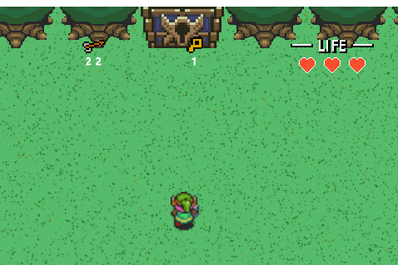
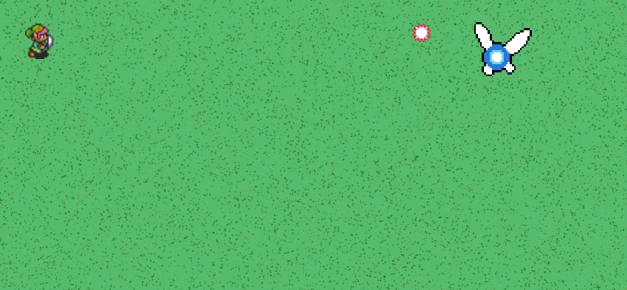
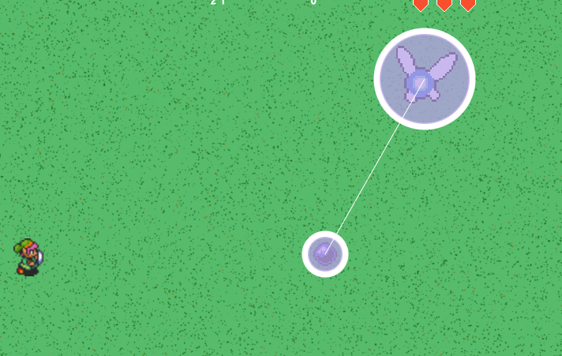
Boss door, Boss, and Shield Mechanic

Slide 11
Development - Issues
There weren’t a whole lot of issues that came up, but I’ll go a little in-depth into the ones that did
Concurrent modification – This was our biggest issue. Dead enemies and projectiles that hit something had to be removed from screen and sometimes ConcurrentModificationExceptions would occur. To get around this, we used java.concurrent.CopyOnWriteArrayList where appropriate. This solved that issue.
Collision – Deciding where to place the player when they collided with an obstacle while still allowing them to move smoothly eluded me for a while. It was eventually solved by first checking if there was an update along the x-axis only and then along the y-axis only and changing that movement variable to 0 if so.

Slide 12
Development – Issues
Exporting to .jar – Though not strictly necessary, I wanted the ability to export to an executable .jar so we could more easily share the game if necessary. To that end, we just had to change how we got resource files, store them in a separate folder and add that folder to the classpath as suggested in the course slides.
Speed – In the early iterations of the game, the speed was terribly slow. A java profiler tool showed this was due to update creating new images from a string stored in the class each and every tick. To get around this, we (for a while) created the image a single time when the class instance was created and then just used the classes existing image in update. This solved the speed issues to the point that we had to move from 60 ticks/sec to 15 ticks/sec because the game was now moving too fast.

Slide 13
Development - Issues
Saving/Loading – Finally, saving and loading was an issue for a while. Eventually, we discovered that this was due to JavaFX’s Image class not being serializable. To fix this we had a couple of options, but as using a PixelGrabber to work around storing the images felt like it would use way more overhead than necessary we decided to create a separate class that stored all of the images as fields and then accessed the appropriate field from the view when it was needed. This had the added benefit of only storing each image a single time instead of once for each instance of that particular object which helps cut down on overhead. After that, to save/load we just had to write the GameModel to file or pass a read-in game file to GameController’s constructor.

Slide 14
Resources
Most of our resources, including all of the sound effects and the sprites, were ripped directly from Zelda: A Link to the Past. The title and background musics were too, but instead of using the originals we recorded them on electric guitar and used Audacity to edit.

